Slide 1
Dativ i lokativ -upotreba
The Dative & Locative Usage

Slide 2
Први падеж, ко-шта
Једног дечка волим ја
Други падеж, кога-чега
Никог другог осим њега
Трећи падез, коме-чему
Он мени, а ја њему
а четврти, шта-ил’ кога
Он је део срца мога

Slide 3
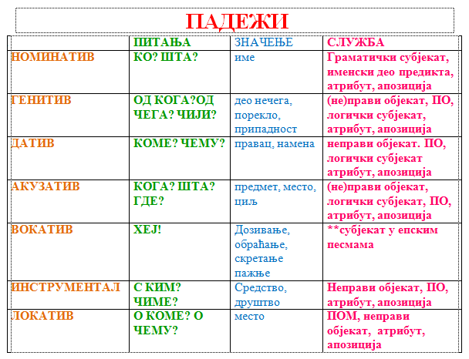
Које падеже имамо

Slide 4
Dativ

Slide 5
Dative case
The dative without prepositions is used to denote a person/object which is the recipient of an action in the predicate.
The dative case always indicates the indirect object. The dative case is generally used to indicate the noun to which something is given, as in "Sin je dao mami poklon". The thing being given may be a tangible object, such as "a book" or "a pen", or it may be an intangible abstraction, such as "an answer" or "help".
The recipient has its own marking, and is called the indirect object. In BCS and many other languages, the direct object is marked by the accusative case, while the indirect object is typically marked by the dative case.

Slide 6
Verbs that go with dative case
Used with the following verbs:
Pričam ti novu priču. pričati-to tell
Pisao je pismo svom bratu.
Čitao je drugu pesmu/ pjesmu. čitati -to read
Kupio sam Ani knjigu. kupovati-to buy
Javi se mami kad dođeš kući. javljati se - to convey a message to someone, to inform
Dala sam ti olovku. dati-to give

Slide 7
Some more examples:
Otac je čitao pesme/pjesme svojoj deci/djeci.
The father read poems to his children.
Student je pisao pismo majci.
The student wrote his mother a letter.
Dete/dijete je kupilo novine ocu.
The child bought a newspaper for his father.
Mario nam je pričao priču.
Mario told us a story.

Slide 8
More examples
Moram joj sada telefonirati. (I have to call her now)
Javio mi je o svom dolasku. (He informed me of his arrival.)
Poslao je mejl svom profesoru. (He sent an e-mail to his professor.)
Zahvalila sam se roditeljima. (I thanked my parents.)

Slide 9
Dative with prepositions
Prema/ka –toward
Idem prema tebi. I am heading toward you.
Ja vozim prema Njujorku. I am driving toward New York.
Avion/zrakoplov leti prema Beogradu. The plane is flying to (in the direction of) Belgrade.
After verbs of motion prema is frequently interchanged with k/ka:
Ja vozim ka Njujorku. Avion/zrakoplov leti ka Beogradu.

Slide 10
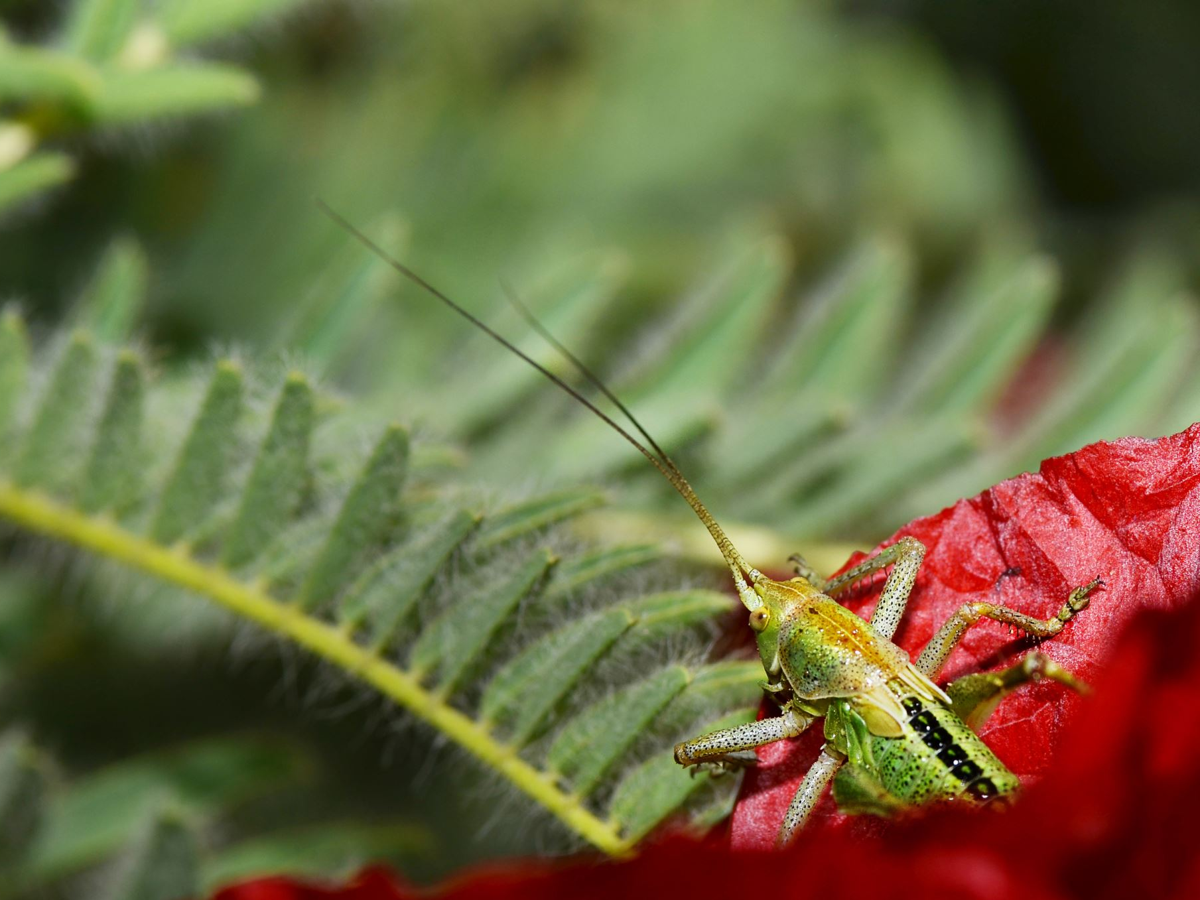
Locative case
is a grammatical case which primarily indicates location. Etymology is Latin: locus-place. The only case which is never used without prepositions (also known as prepositional case).
The following prepositions govern the locative case:

Slide 11

Preposition O:
O “about, of” after verbs: govoriti, reći (to talk, say about), misliti (to think)
Ja govorim o vama, a ne o njima.
Marija misli o njemu.
Mi govorimo o američkoj istoriji/povijesti.
Mama misli o svojoj deci/djeci.

Slide 12

Po “on or along the surface of smth”
Ja šetam po parku. I walk around the park.
Idem po staroj ulici. I walk along an old street.
Putujem po Americi. I travel around America.
Po mom mišljenju /according to my opinion

Slide 13
U (in, at), NA (on, at)
U and Na are used with both Accusative and Locative cases, depending on whether motion or location is involved. If talking about where something or someone is located, use locative case. Locative case is usually followed by the verb biti (to be) to mean action, or presence in, or, at some place.

Slide 14
Locative na/u
Ja sam u velikoj banci. (verb to be, place)
Milena je u školi.
Mačka spava na terasi. (terasa-balcony)
Ja sam na univerzitetu/sveučilištu.
Oni žive u Splitu. (Split-a city in Croatia)
Ana je bila na Kubi. (Kuba-Cuba)
Deca/djeca se igraju u pesku/pijesku. (sand)

Slide 15
Accusative Locative
Motion/destination/
direction:
Idem u banku.
Idem na koncert.
Putujem na Balkan.
Location/presence/verb “to be”:
U banci sam.
Na koncertu sam.
Živim na Balkanu.

Slide 16
Usage Overview
Follow the Miro Link

Slide 17
Za sutra
Homework- Lokativ/Dativ
Read pages about instrumental in textbook

